Slide 1
World Café:
Coping with Stress
A Customizable Slide Deck for Building the Capacity of Families

Slide 2

How to use these slides
This slide deck a World Café style discussion for families to talk about mental health.
It can be used by family-serving organizations in caregiver learning sessions.
Facilitators can customize the designated areas of the deck for their communities and present it to families at family engagement nights, parent workshop events, or during other community gatherings.
Facilitation Notes:
To customize these slides for your audience:
Google Slides: Navigate to File > Make a Copy > Entire Presentation
PowerPoint: Navigate to File > Download > Microsoft PowerPoint (.pptx)
See the World Café Session 1 Facilitation Guide for details about materials needed, group size, slide talking points, and more.
See the Notes section of each slide a script. Note that words in [brackets] refer to actions.
You’ll see boxes throughout the deck that look like this. This indicates an area that you should personalize the deck to fit your community.

Slide 3

World Café:
Coping With Stress
Your Name
Date
Organization
Notes:
FACILITATOR SCRIPT
Hello, and welcome to our world café, where you will have the opportunity to share thoughts and advice with other adults about how they cope with stress. I am [fill in your name], the [fill in your role] here at [fill in name of school]. I am so glad to see you and look forward to meeting you and learning from you. I want to make sure that everyone has a name tag, so if you do not have one yet, please make one now from the name tags on the table.

Slide 4
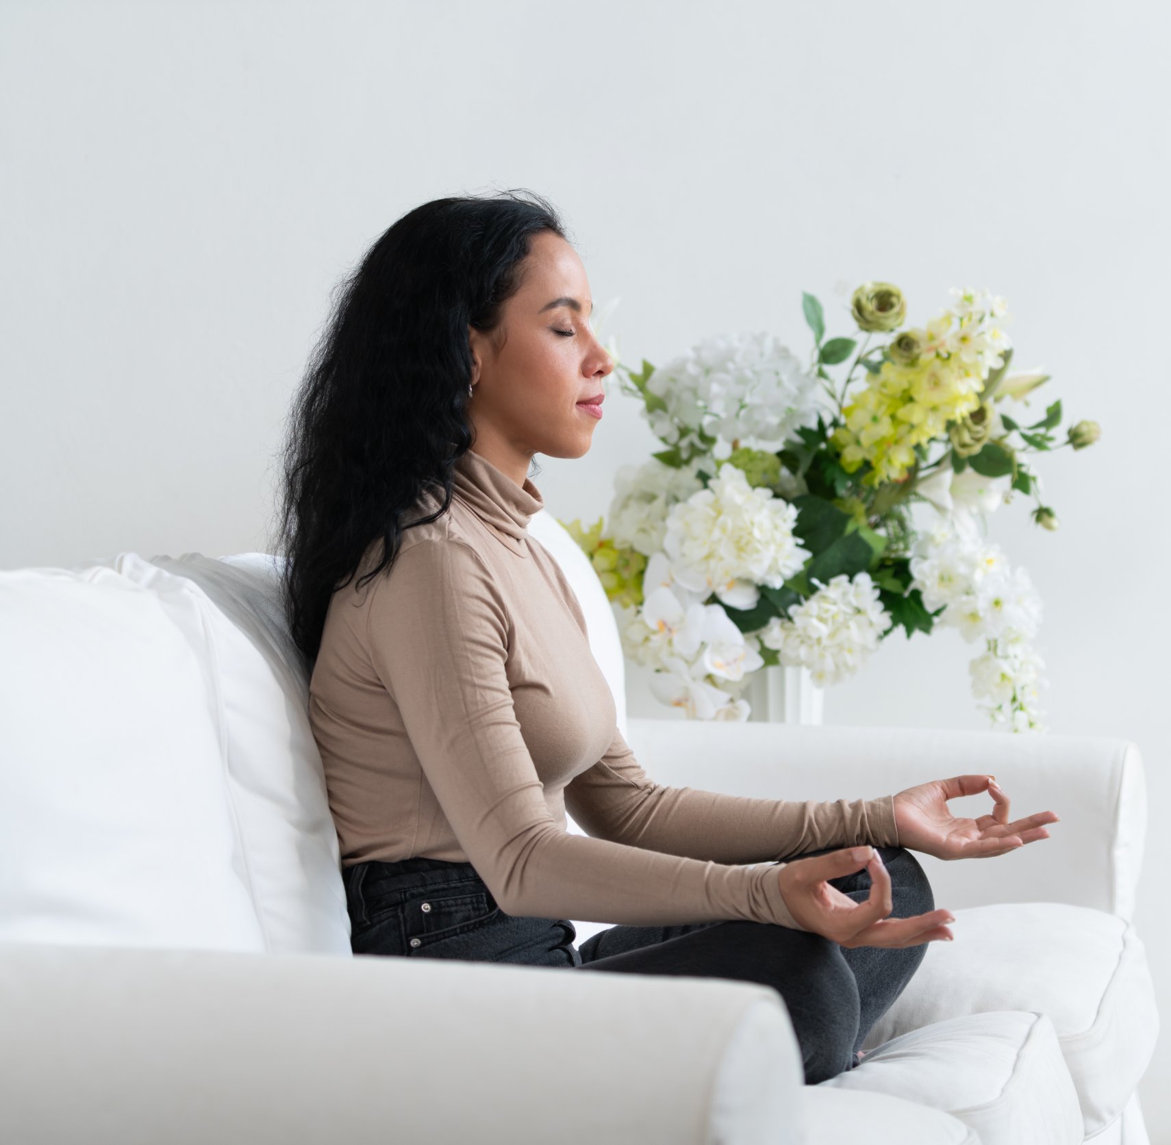
Objectives
Learn from each other
Connect with one another
Learn different ways to handle stress
Notes:
Script
Our objectives for this meeting are to learn from each other, get to know each other and connect – or reconnect – with one another, and to share some of our ideas for coping with stress.

Slide 5

Agenda
Group agreements (2 minutes)
Icebreaker (5 minutes)
Importance of recognizing and handling stress (5 minutes)
World Café discussions
  World Café round 1 (15 minutes)
  World Café round 2 (15 minutes)
  World Café round 3 (15 minutes)
  Return to original group (10 minutes)
Harvest and closing (15 minutes)
Notes:
FACILITATOR SCRIPT
Here is our agenda for this [evening/meeting/afternoon]. First I will provide you with a brief introduction to stress and why recognizing it is important. Then we will do a short icebreaker before I describe the world café process. The majority of the meeting will be spent in three rounds of discussion, followed by some time to share what we have learned with each other in what's called the harvest round . Any questions about the agenda?

Slide 6

Group Agreements
Engage in self-care
Make space for learning
Share the floor
Notes:
FACILITATOR SCRIPT
Before we get started, I want to set some basic rules for world cafes.

Slide 7

Icebreaker
At your table, share:
Your name
The ages of your child(ren)
Something that has brought you joy in the last few weeks
Notes:
FACILITATOR SCRIPT
Ok, let’s get to know each other a little bit!

Slide 8
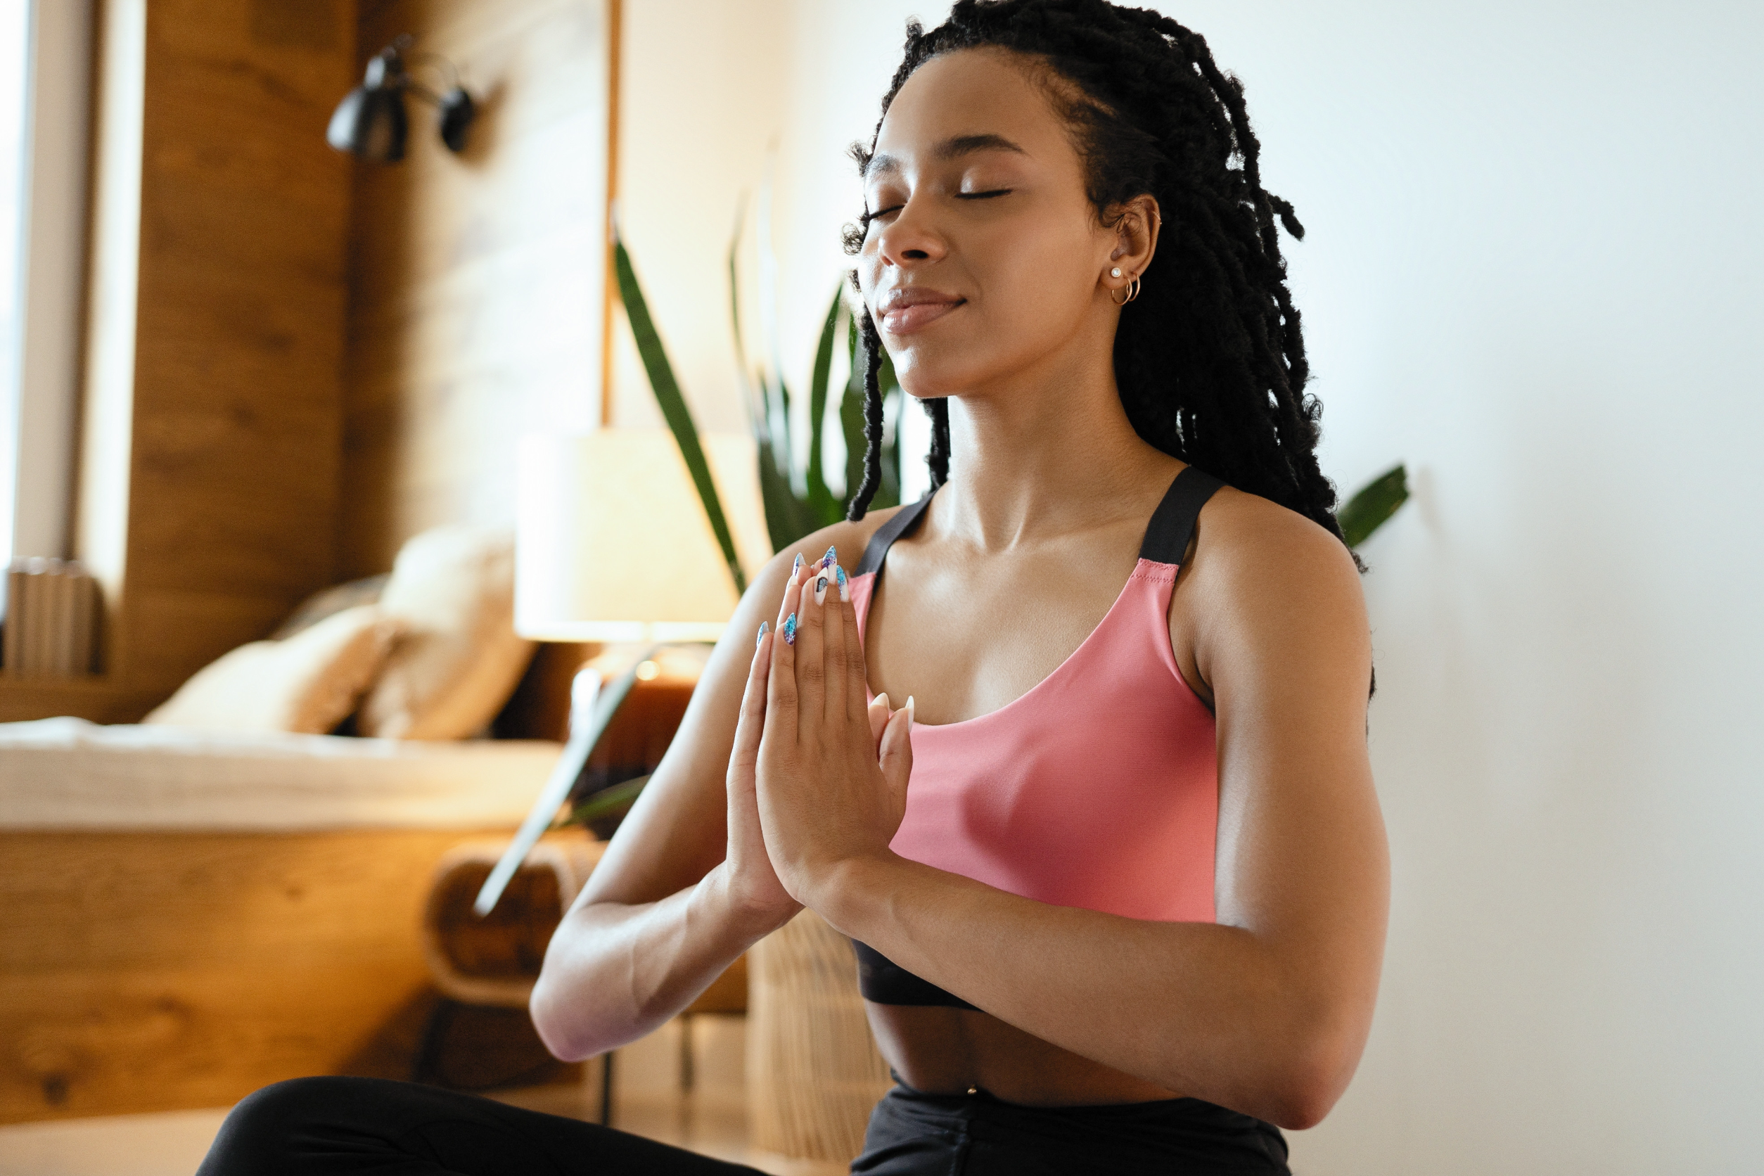
Why Self-Care is Important?
Notes:
FACILITATOR SCRIPT
Before we start our discussions, I’d like talk about why self-care is important. So many of us run around helping other members of our families, that we do not take care of ourselves. But we need to. Stress, anxiety, and depression can lead to poor health conditions. They can increase the risk of developing heart disease, stomach problems, obesity, or diabetes. Moreover, if you are stressed or not feeling well, your own capacity to help your loved ones decreases. Studies have found that the stress or anxiety that parents or caregivers feel has an adverse affect on the children they care for. Conversely, studies have found that parents who practiced self-care and showed compassion for themselves were more likely to enjoy parenting, have more patience, and have more positive interactions with their children. They were more able to deal with challenges as well as setting a good example for their children. When you are on an airplane, what do the stewards say to do first if the oxygen masks are released? Put your own mask on first so that you are better able to help your child. The same is true with our own mental health. It is important to take care of ourselves not just for our own sake, but for our children’s.

Slide 9
Physical ailments, such as headaches, body pains, stomach problems, or skin rashes
Feeling sad, fear, anger, worry, numbness or frustration
Changes in sleep: nightmares, restlessness, sleeping too much or not enough
Changes in desires and interests
Weight and appetite changes​
Risky behavior​
Signs of Stress
Worsening chronic health problems
Increased use of alcohol or drugs
Lack of energy​
Trouble concentrating​ or making decisions
Notes:
FACILITATOR SCRIPT
Here is a list of some of the signs of stress. We’ll be discussing how we know when we are stressed in a little bit, but this list provides a starting point for our discussion. Stress appears in a number of different ways and can appear differently at different times. Knowing when you are feeling stressed will alert you to a need to practice self-care.
If you have any of these symptoms for more than two weeks, seek help from friends, family, or a professional. If you start to self-harm or have thought of suicide, call or text 988 immediately.

Slide 10
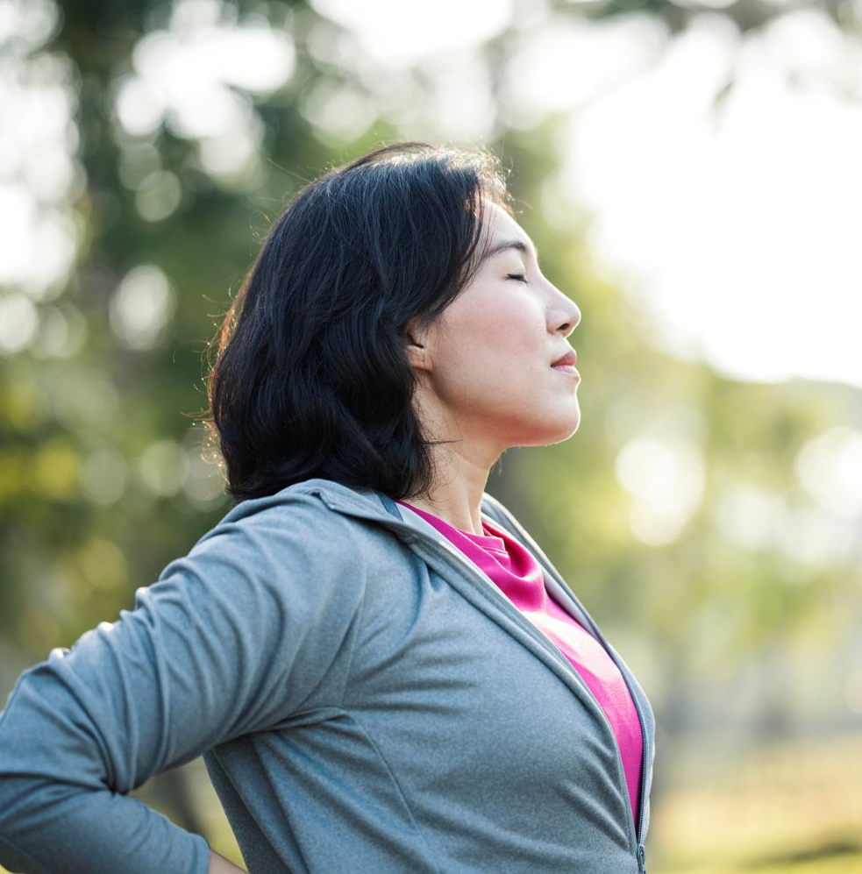
Coping with stress
Good nutrition
Exercise
Establish a sleep routine
Get up frequently and move
Take a break from the news and social media
Decrease alcohol use
Practice relaxation
Connect with others
Take a walk or get outside
Notes:
There is always going to be stress in our lives, so how can we cope with it? Good nutrition, consistent exercise, and enough sleep are some good ways to cope with stress. Movement of any kind, such as dancing, going for walks, or even gardening or doing housework can help relieve stress. Other ideas include taking a break from the news or social media and practicing relaxation techniques such as mindfulness or meditation. Going out with friends and connecting with others can also help with stress.

Slide 11
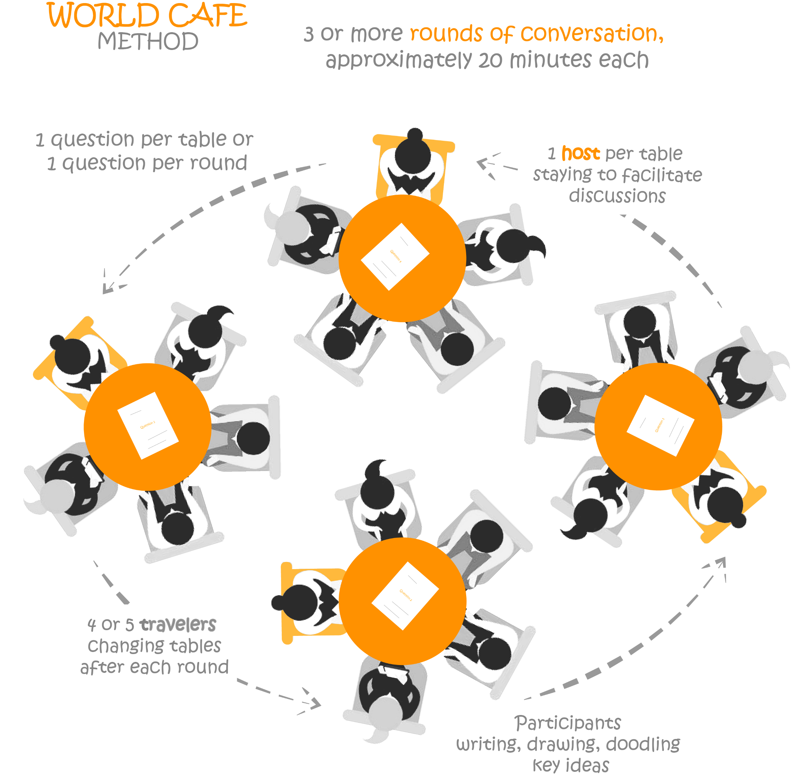
What is a World Café?
Image Source
Notes:
FACILITATOR SCRIPT
Now that we’ve gotten to know each other a little bit, let’s learn about the world café model.
The world café is a process for sharing ideas, solving problems, and gaining new perspectives. It is used by corporations, non-profit organizations, and parent groups, among others, for brainstorming sessions, to learn from each other, and to strategize.
We’ll be using it to start conversations and to share concerns and ideas about mental health.
Here’s how it works.
I will be putting a question up on the screen and you will have 15 minutes to think through and talk about the question with your table. I have three questions that I will post and you will have 15 minutes to talk about each one. I will give you a 2 minute warning when your 15 minutes are almost up. At the end of the time, or round, everyone at the table, except for one person who is the host – and we’ll talk about that in a moment – will move to another table. Spread out and try not to sit with any of the same people.
When we start the second round, the person who is host will briefly describe some of the main insights and thoughts that the first table had about the first question. You will have 15 minutes to discuss the second question. At the end of the second round, everyone except the host will move to a different table. As at the start of the second round, the host greets the new people who arrive at their table, explains what was discussed during the previous round, and the discussion about the third question begins.
At the end of this 15 minute round, everyone should return to their original tables. You will have 10 minutes to share what you learned with each other with your table. When those 10 minutes are up, you will select someone from your table to share any main insights with the whole group.
It may sound a little complicated, but I’ll guide you through it and remind you of the steps.
Right now, the first thing you should do is select a table host. Take a moment now to decide who will be the host. [pause] Hosts, you will notice that there is a paper on the table that is labelled Table Host Guide. Take a look through the directions – it is very simple, but let me know if you have any questions.
Finally, you’ll notice that there are pens and paper on the table. These are for you to use and jot down ideas that come to you. Use words, abbreviations, or drawings – whatever helps you! Hosts, this is a good place to jot down – or ask others to jot down – ideas that you will want to share at the beginning of the next round.

Slide 12
Questions
1
2
3
What are your strengths?
What are some of the major lessons you’ve learned from periods of stress?
What do you think you could do differently to (realistically!) prioritize self-care?
Notes:
Facilitator Script
This is a preview of the questions you’ll be discussing each round. A couple of things to point out here:
For the first question, you’re going to be sharing your strengths. You may be wondering what that has to do with stress. Well, if we’re trying to practice ways of coping, we’re going to be more successful if the things we come up with are things that already tap into our strengths or interests. If you’re not a yogi, then yoga might not be a good coping strategy. If you’re really good at time management, and that’s your superpower, then knowing that can help with answering #3, for example.
Similarly, we can all learn from mistakes or missteps we’ve made, and we can use this time to reflect and share the things we’ve learned from really stressful times in round 2.
And then finally, I know that it is not realistic for most working parents to just, say, get a massage every week, right? So for #3, think about what you’re good at, think about what you’ve learned in your life so far, and talk with your group about some realistic ways you might be able to shine a little more light on yourself sometimes.

Slide 13
Question 1
What are your strengths?
Notes:
FACILITATOR SCRIPT
[Set timer for 15 minutes.You can walk around the tables, answering questions or helping the conversations. With two minutes remaining, let them know.]
When time is up:
Ok, time is up. Everyone except the table host should now move to a new table. You do not need to stay with your group. Table hosts, please stay where you are and greet the new members of your table. Prepare to summarize some of the main points from the previous discussion.

Slide 14
Question 2
What are some of the major lessons you’ve learned from periods of stress?
Notes:
FACILITATOR SCRIPT
[Set timer for 15 minutes.You can walk around the tables, answering questions or helping the conversations. With two minutes remaining, let them know.]
When time is up:
Ok, time is up. Everyone except the table host should now move to a new table. You do not need to stay with your group. Table hosts, please stay where you are and greet the new members of your table. Prepare to summarize some of the main points from the previous discussion.

Slide 15
Question 3
What do you think you could do differently to (realistically!) prioritize self-care?
Notes:
FACILITATOR SCRIPT
[Set timer for 15 minutes. You can walk around the tables, answering questions or helping the conversations. With two minutes remaining, let them know.]
When time is up:
Ok, time is up. Everyone please return to your original tables.

Slide 16

Harvesting:
Sharing insights from your travels
What are some of the major lessons you’ve learned from periods of stress?
What are your strengths?
What do you think you could do differently to (realistically!) prioritize self-care?
Notes:
Facilitator Script
We’re going to take 10 minutes with our original group to discuss the points that stood out to you during each round. After about 8 minutes, I’m going to give you a heads up to select a spokesperson who will share your group’s main takeaway from this experience with the full group.
[set timer for 10 minutes]
[You can walk around the tables, answering questions or helping the conversations]
[With two minutes remaining, let them know that they should start summarizing and select someone as spokesperson]
[When time is up, say the following]
Ok, time is up. Which table would like to go first?
[Facilitate share-out]

Slide 17
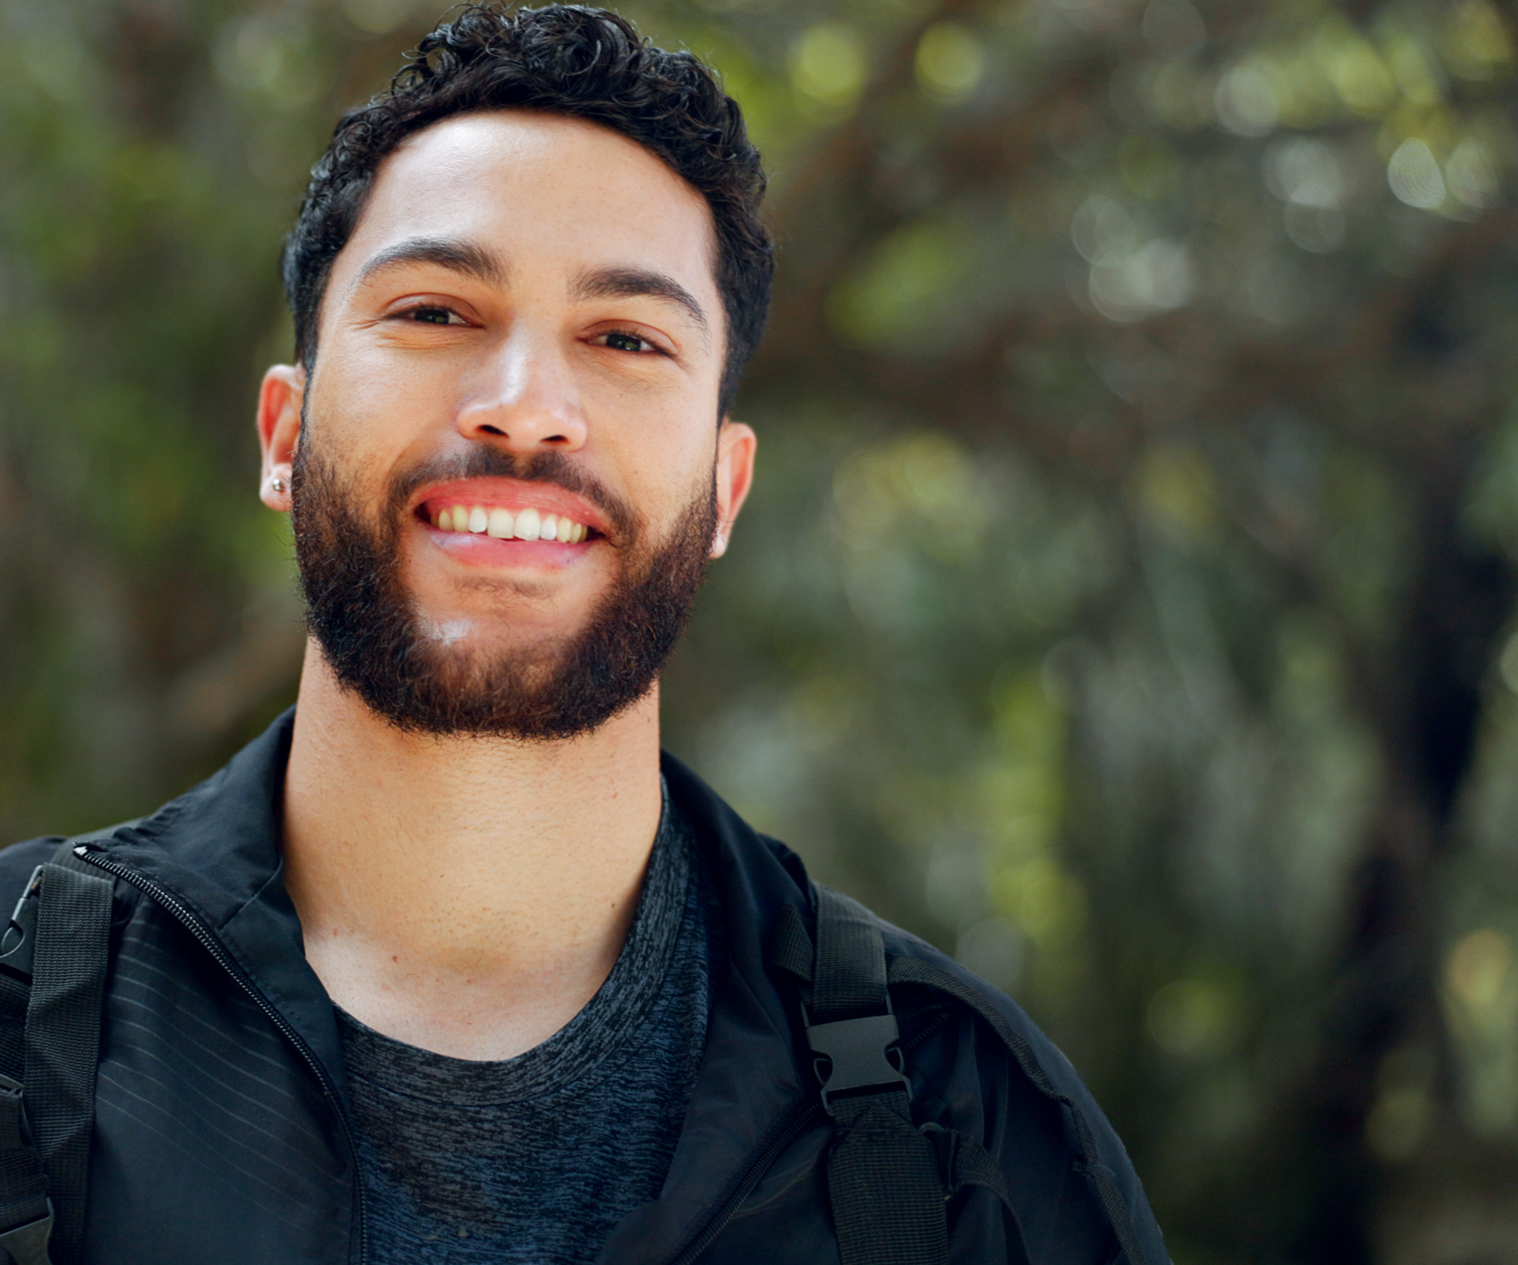
Reflection
On a post-it note, write one priority you identified for yourself
Bonus: Share it with your neighbor!
Notes:
FACILITATOR SCRIPT
I’d now like you all to think back on what you’ve heard and discussed and think about one word you’d use to summarize this discussion and experience. You can write it on a post-it to take with you, or share your word with your neighbor.

Slide 18

Thank you!
Your contact information
For more information about youth mental health, visit confidentconnections.org
Notes:
Any last thoughts or questions anyone would like to share?
Well, thank you! And I hope that you enjoyed our time here together.

