Slide 1
Introduction to Youth Mental Health
A Customizable Slide Deck for Building the Capacity of Families

Slide 2
How to use these slides
This slide deck provides an introduction to youth mental health for families and can be used by family-serving organizations in caregiver learning sessions.
Facilitators can customize the designated areas of the deck for their communities and present it to families at family engagement nights, parent workshop events, or during other community gatherings.
Facilitation Notes:
To customize these slides for your audience:
Google Slides: Navigate to File > Make a Copy > Entire Presentation
PowerPoint: Navigate to File > Download > Microsoft PowerPoint (.pptx)
See the Introduction to Youth Mental Health Facilitation Guide for details about materials needed, group size, slide talking points, and more.
See the Notes section of each slide a script. Note that words in [brackets] refer to actions.
You’ll see boxes throughout the deck that look like this. This indicates an area that you should personalize the deck to fit your community.

Slide 3
Introduction to Youth Mental Health A Learning Session for Families
Your Name
Date
Organization
Notes:
Script
Greetings everyone, it is so nice to see you all here [tonight, today]. We will be spending approximately 30 minutes talking about mental health and well-being, how mental health differs from mental illness, how to know when to get support, and available resources in our community. First let me introduce myself. I’m [NAME], the [TITLE]. My role at X school is [please add]

Slide 4
Objectives
Define mental health, including youth mental health
Learn how to support mental health at home
Learn when and how to get professional support
Learn about national and local resources
Notes:
Script
Today we’re going to talk about youth mental health. We’ll talk about what it is, how to support your child at home, and when to get professional help involved. We’ll also learn about the resources available locally and nationally

Slide 5
Group Agreements
1
Engage in self-care
2
Make space
for learning
3
Share the floor
Notes:
FACILITATOR SCRIPT
Before we get started, I want to set some basic rules for our time together.

Slide 6
What do you think about when you think about mental health?
Notes:
Script
I’d like to start by hearing what you think of when you think of mental health. What does it mean to you? How do you define it?
[Thank participants for their responses]

Slide 7
“Mental health is a state of mental well-being that enables people to cope with the stresses of life, realize their abilities, learn well and work well, and contribute to their community.” - World Health Organization
“Mental health includes our emotional, psychological, and
social well-being. It affects how we think, feel, and act.”-
Centers for Disease Control and Prevention
Notes:
Script
Here are two official definitions of mental health, one from the World Health Organization and one from the Centers for Disease Control and Prevention, typically called the CDC.
Both of these definitions emphasize that mental health is one indicator of well-being.
It influences how we make and keep relationships, how we express our feelings, how we make decisions, and how we manage the stresses, challenges, and joys of life. It is influenced by our environment, experiences, and backgrounds. It is also deeply connected to physical health: our mental health can affect our physical health, and our physical health can impact our mental health. For example, having depression (a mental health condition) can increase a person’s risk for heart disease (a physical illness), and having diabetes (a physical illness) can increase a person’s risk for anxiety (a mental health condition).
Mental health itself is not good or bad; it is one dimension of well-being. Just as parents learn to recognize some basic signs of physical illness like fever, rash, or cough, we can also learn some basic signs that our children may be struggling with a condition that's impacting their mental health like loneliness, anxiety, or depression.
It is relevant to everyone and at every stage of life. A person’s mental health can change over time and may be influenced by life circumstances and events, hormonal changes, genetic factors, relationships, medical conditions, and alcohol or drug use.

Slide 8
Three Components of Mental Health
Emotional
well-being
Social
well-being
Psychological well-being
Youth have mental health, too! AND their brains and bodies are growing and changing in significant ways
Notes:
Script
Let’s break this down a little more.
The definition the CDC uses includes three areas, emotional, psychological, and social. While these may be used interchangeably, they are slightly different and together provide a broad spectrum of mental wellness.
It should also be noted that the expectations for mental wellness grow and change as one changes, so that what may be expected of a 35 year old should not be expected of a 4 year old. As a child grows, there are behavioral, social, and emotional changes that develop over time. These are part of the age-related developmental milestones. In addition, we can do things, such as self-care, or create conditions, such as supportive climates, that support our own and other’s mental wellness.
When we talk about emotional well-being, we’re talking about the ability to recognize and manage our emotions.
For example, this is the ability to recognize and control our anger in appropriate ways. Going back to what I just mentioned about age-related developmental milestones, this is something a two year will probably still need to learn, but an 18 year should be able to manage. It is also recognizing happiness or fear or other strong feelings and communicating it appropriately.
Would anyone else like to share an example of emotional wellness? [Respond] What about for youth? What does emotional well-being look like for children and teens? [Respond]
By psychological well-being, we mean the ability to cope with the ordinary demands and stresses of life and to make healthy choices. It also reflects the ability to find satisfaction and motivation to reach goals.
For example, it involves knowing how to advocate for yourself or how to keep moving forward if you meet a roadblock.
Would anyone else like to share an example of psychological well-being? [Respond] What about for youth? What does psychological well-being look like for children and teens? [Respond]
And by social well-being, we are talking about the capacity to create and keep positive relationships with people.
It includes having close friends to share joys and sorrows with or being able to navigate conflict in a way that leads to an effective outcome.
Would anyone else like to share an example of social well-being? [Respond] What about for youth? What does social well-being look like for children and teens? [Respond]

Slide 9
Youth Mental Health Myths and Truths
Myth: Mental health issues won’t affect my child.
Truth: It is true that most children show positive mental health. At the same time, diagnosis of depression and anxiety in children has been increasing. About 1 in 6 youth aged 12-17 have experienced a depressive episode in the last year.
Truth: Mental health conditions can be influenced by life circumstances and events, hormonal changes, genetic factors, relationships, medical conditions, and alcohol or drug use.
Truth: Sometimes mental health issues do look like typical behaviors of childhood, like moodiness or difficulty handling conflict. However, there are some mental health conditions, like anxiety or attention-related disorders, that affect children. Additionally, 75% of mental health disorders appear before age 24. Most conditions are treatable with early intervention.
Truth: Addressing known risk factors, such as exposure to trauma, can lower the chances that youth will develop mental health conditions.
Myth: Mental illness is a sign of weakness.
Myth: Children don’t experience mental health issues. It’s just a phase.
Myth: You can’t prevent a mental health condition.
Adapted from John Hopkins Medicine and SAMHSA’s Mental Health Myths and Facts and Mental Health America
Notes:
Script
Now that we’ve heard what mental health is, let’s talk a little bit about what it isn’t and some of the myths that surround mental health. These are ideas that are held by lots of people and one of the reasons that we need to talk more about mental health.
Mental health issues won’t affect my child. [Click for truth]. Mental health issues can affect anyone. It can be influenced by genetic factors, life circumstances, physical health, and many other factors. Most parents report that their children are healthy, and at the same time, rates of diagnosis of depression and anxiety have increased over time. [Click for #2]
Mental illness is a sign of weakness. [Click for truth]. As I’ve mentioned, there are a range of influences on someone’s mental health, including on the development or presentation of a mental illness. It is not the same as a personal failing or weakness, and oftentimes has to do with how a person’s brain and body work. [Click for #3]
Children don’t experience mental health issues. [Click for truth]. Most mental health conditions actually appear before age 24, and some much earlier than that, including in young childhood. Knowing this and talking to your pediatrician if you have questions or concerns is really important and a powerful means for early intervention. Talking to professionals you can trust, as well as knowing your child well and paying close attention to their growth and development, are powerful means of prevention. [Click for #4]
You can’t prevent a mental health condition. [Click for truth]. While some mental health conditions are genetic or built into our bodies, they can be prevented or positively influenced by addressing risk factors.

Slide 10
We all have mental health
Source: YouTube
Notes:
Script
Here’s a short video on mental health
[Link: https://www.youtube.com/watch?v=sgCtfRGLmi8]
[When finished]
What stood out to you about that?

Slide 11
Supporting Mental Health at Home
1
2
3
Mind
Body
Relationships
Practice mindfulness or mindful breathing
Create calm spaces in your home
Schedule in down time for your family to relax
Establish routines that work for everyone
Be mindful of family screen time
Eat a variety of foods
Encourage movement
Establish and model healthy sleep habits
Practice self-care
Make time for friendships
Reach out to others for laughter, connection, support, and advice
Seek out professional help when needed
Notes:
Script
Many of the activities that can be used to support SEL are the same as those for supporting mental health, such as setting up routines. Here are some other suggestions on how you can support healthy mental health with your children at home.
One that is often overlooked is providing for and supporting your own mental health. Experts have found that if a parent or teacher is stressed or depressed, it impacts the student. Like when on an airplane the stewards say to put your own safety mask on first before assisting your child, it is important for you to feel mentally and emotionally well to support your child. This does not mean that you should be happy all the time – quite the opposite. Demonstrating to your child that you are aware of your own emotions and can manage them in appropriate ways is important. Be sad, frustrated, or angry, but show how you can control it in productive ways so that your child has a model. And practice your own self-care. Go out with friends, exercise, practice good nutrition, or other activities that support your own mental health. Many of the suggestions on this list are excellent for you to practice as well.
We’ve already touched briefly on encouraging exercise, but I do want to emphasize that your child should be able to pick the type of exercise. It doesn’t need to be on the best sports team or to be the fastest runner. It can be practicing yoga every morning, or going for a bike ride, dancing to music, or walking in the evening. Doing something that increases the endorphins in the body can greatly improve mood and mental well-being.
Similarly, good nutrition can have an impact on mental health. Make sure everyone in the family has fruits, vegetables, nuts (if there isn’t an allergy in the household!), and low-fat snacks, such as yogurt or a whole grain snack bar.
We already discussed setting up routines, but also try to schedule some time to slow down during the day. Our society is so rushed to do things, that it is important to step back and have some time to think and regroup. It could be taking a walk, practicing mindfulness activities, or reading a book.
Create spaces that are calming and uncluttered if possible. This can be tricky, but for a child or young adult who is having mental health challenges, having a safe, quiet space where they know they can go and not be disturbed can be important.
We’ve all heard a lot about monitoring screen and/or phone time and you may want to share ideas for what has worked – or hasn’t - in your household. I know of some people who have a rule that phones are not allowed in the bedroom or have to be in the parents’ possession by a certain time every night. What ever you do, make sure you practice it yourself as well. Again, you are setting the example of how to monitor your actions. Doom-scrolling is not good for anyone.
Other suggestions include practicing mindfulness, setting good sleep habits of the same bed time every night and 8 - 11 hours of sleep for most children between the ages of 6 to 18, and supporting your child’s relationships with their peers.

Slide 12
What to Look Out For
If your child displays these signs, talk to your pediatrician to see if they could benefit from additional support
Social-Emotional Changes
Feeling sad, empty, or hopeless all or most of 2 or more weeks
Extreme emotional outbursts
Trouble concentrating
Changes in attitude towards school
Behavioral Changes
Changes in eating habits
Behavior that harms others
Weight change
Difficulty sleeping
Hurting oneself or talking about hurting oneself
Talking about death or suicide
Source: Mayo Clinic
Notes:
Script
Ok, so how do you know if you should be concerned about your child? Sometimes this is tricky because children and teens are growing and changing so much and so fast, and so many of the behaviors of childhood are both totally typical and also sometimes a sign of a concern.
The most important thing you can do is pay attention to your child and keep an open, honest, and non-judgmental relationship with them. You know your child best.
This is an overview of some of the signs that, if displayed consistently for 2 or more weeks, might prompt you to talk to your child’s pediatrician. These are not all necessary cause for alarm – it is typical for a 13 year old, for example, to have really powerful emotional outbursts, or for an adolescent to go through a period of weight change.
Even a curiosity about death isn’t necessarily a cause for alarm, though talking about death or suicide or self-harm behaviors should never be ignored or punished. If you are worried about your child’s safety, call 988, the suicide lifeline, for support.

Slide 13
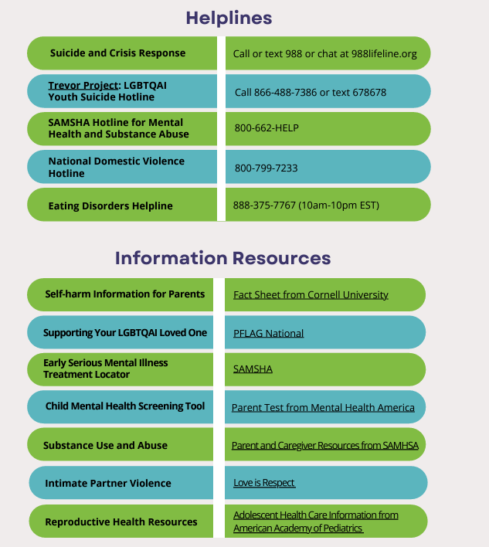
Mental Health Support
If you are concerned about the immediate safety of yourself or someone else, call 911 (emergency services) or 988 (suicide and crisis lifeline)
Include the contact information for local resources such as school-based mental health professionals or community health clinics
Notes:
Script
Here are some national and local resources. [Describe the local resources]
If your child shows any signs of self-harm or is struggling or having thoughts of suicide, call or text 988 or chat at 988lifeline.org. In a life-threatening situation, call 911.

Slide 14
What are we doing to support your child?
Include your school’s mental health resources and programming. You might consider including information about:
SEL curriculum
School climate programs, such as mindfulness, restorative justice, trauma-informed practices, school discipline policies, practices of kindness or for developing community
Mental health education
Peer support programs
Parent training programs
PBIS or MTSS programming
School mental health resources and programming
Collaborations with local community resources and services
Notes:
Script
Here is what we are doing to support mental health….

Slide 15
We are here for you!
Include the contact information for anyone at your school or organization that could be a mental health resource for families
Notes:
Main points
Review information
Script
Here are the names and contact information for people at our school and in our school district.

Slide 16
Thank you!
Your contact information
For more information about youth mental health, visit confidentconnections.org

